Slide 1
We can…
K.V.V. Satya Sekhar
Solar power
and
Industrial Electricals

Slide 2
About US
Started in 2012 by an Electrical Engineer
with 24 years of Industrial experience in Projects, Maintenance & Energy Management
with an aim to
PROMOTE GREEN ENERGY
For a
CLEAN & BETTER ENVIRONMENT.

Slide 3
WE DEAL with
S
O
L
A
R
Power systems
Water Heating Systems
Fencing
Water Pumping
Street Lights
And Energy Conservation Items like BLDC Fans, AC Power Savers…

Slide 4
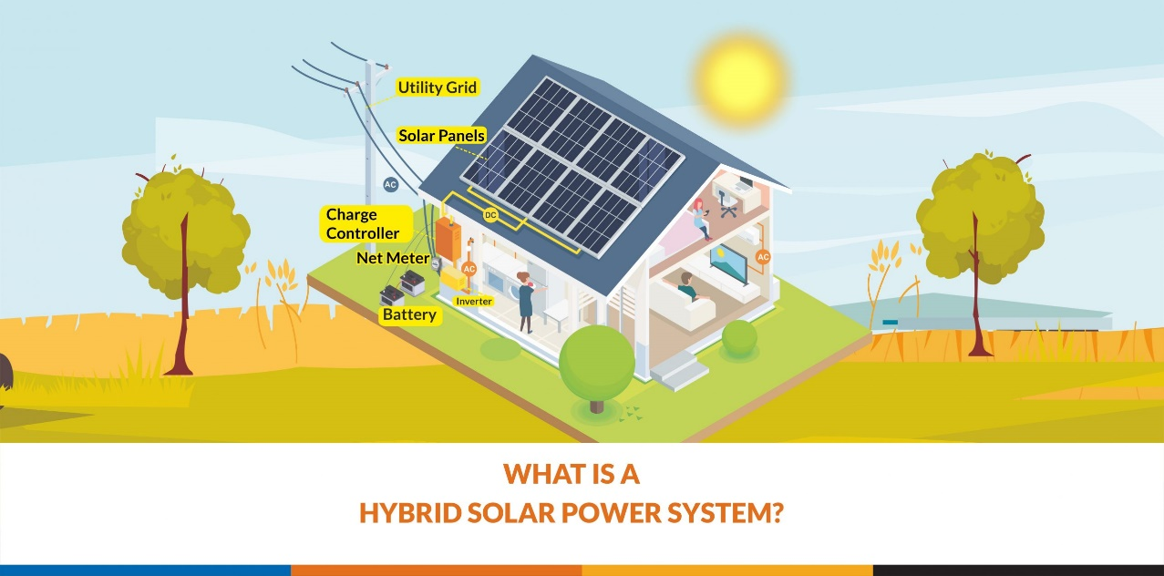

Slide 5
 | Electrical inverter | Solar power system
Initial Cost | Less | High
Back up during power fail | Yes | Yes
Consumption of main power | Continuous | Limited
During power availability | No use | Useful
Return On Investment | No | Yes

Slide 6
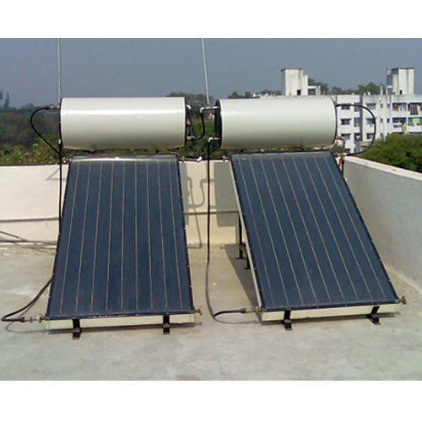
Solar Water Heaters Solar Street Lights

Slide 7
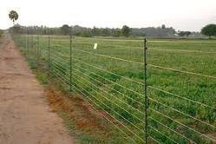
Solar Fencing

Slide 8
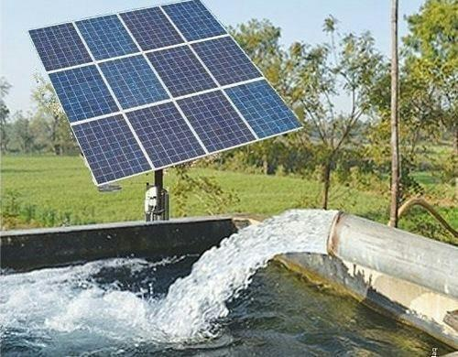
Solar Water Pumping systems

Slide 9
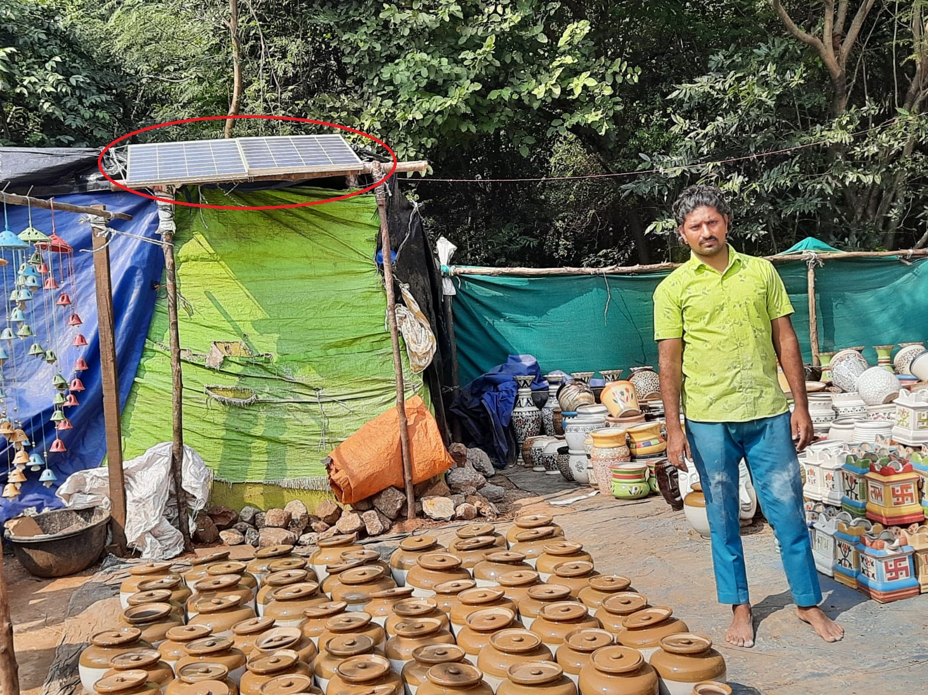
EVERY ONE can afford SOLAR ENERGY
Proved It….
Notes:
Proved It….

Slide 10
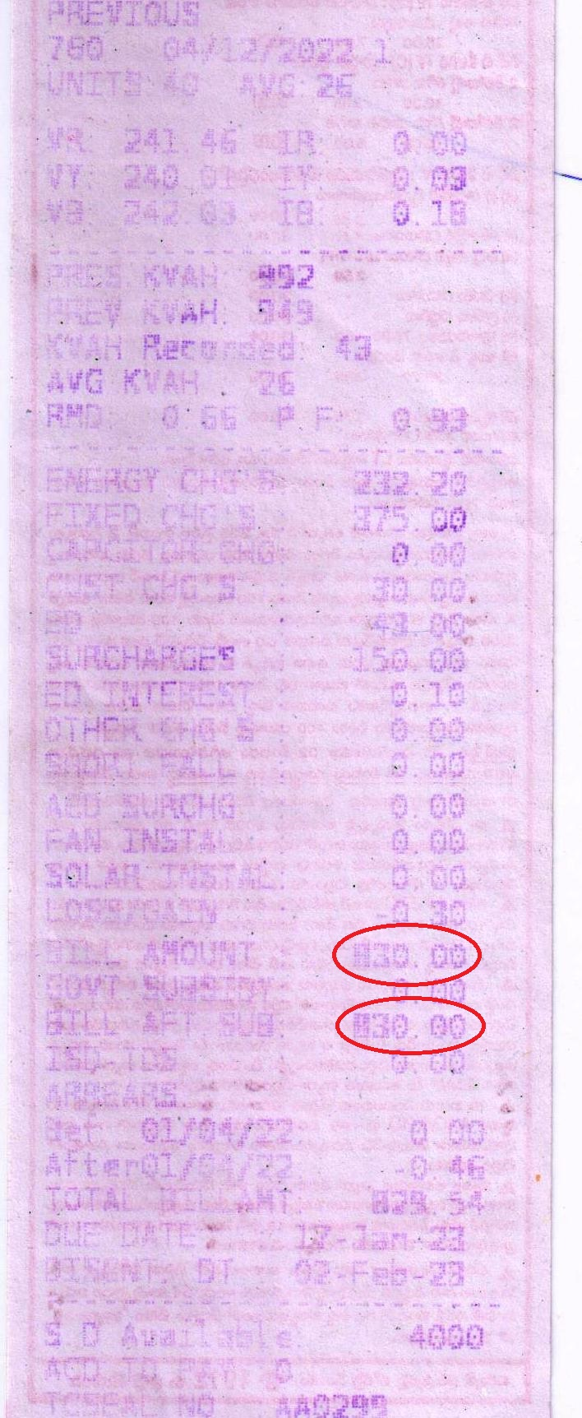
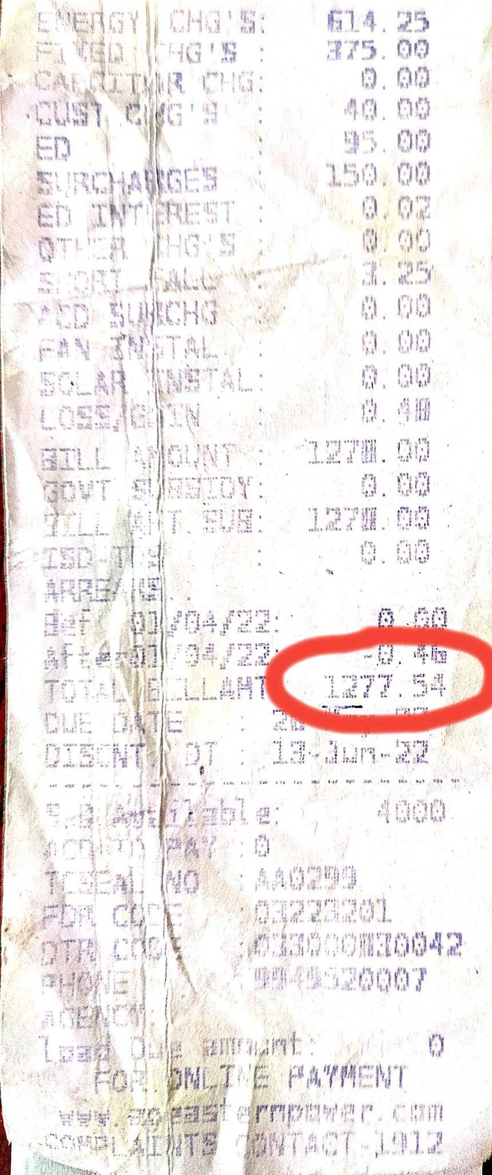
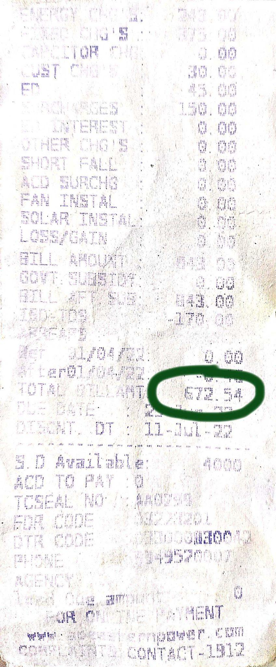
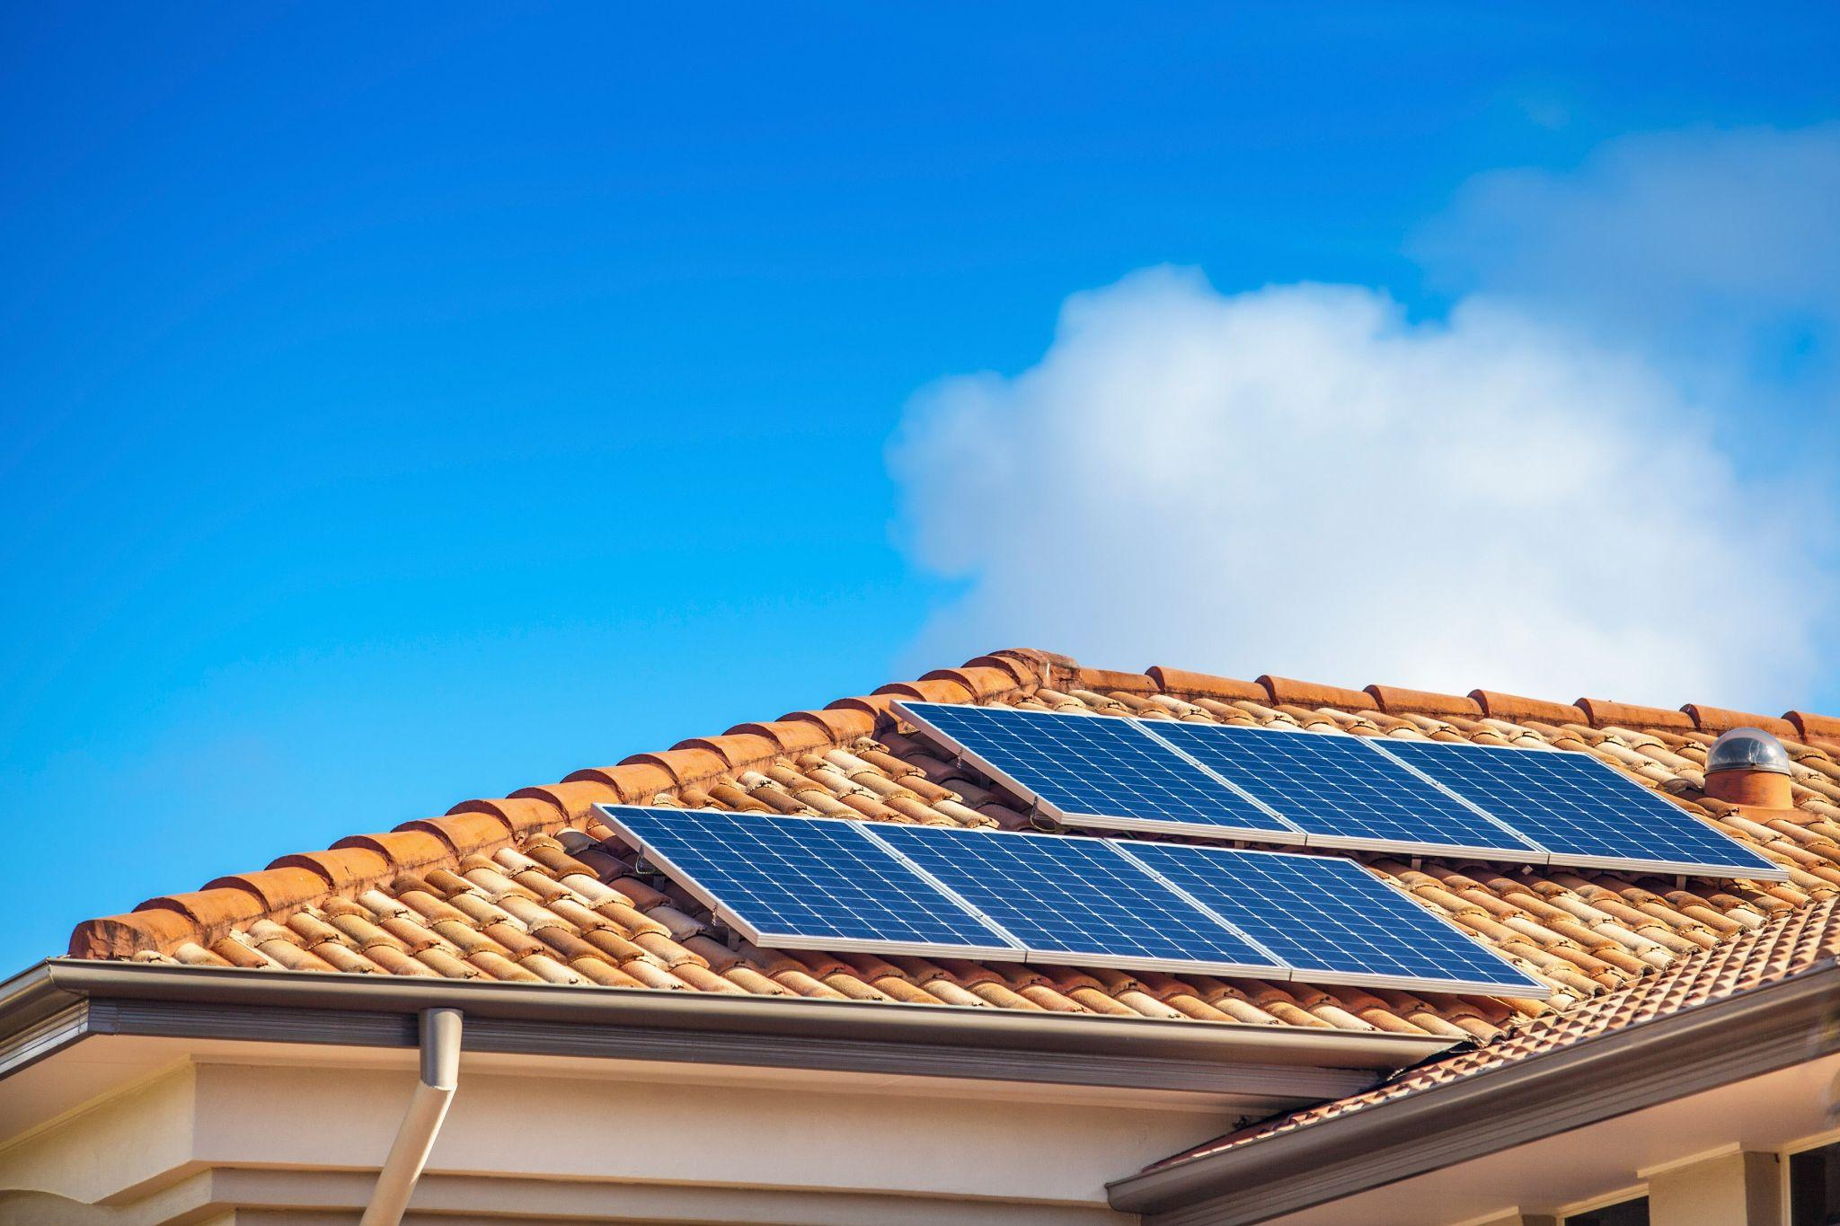
Before
Office @ Kurmannapalem
After SPGS
RECENT CURRENT BILL

Slide 11
We are Channel Partners to

Slide 12
Everything we utilize in daily life can be solar sourced
Lights
Fans
Geysers
Cookers
Washing Machines
Refrigerators
Air conditioners
Water Pumps
&
Vehicles

Slide 13
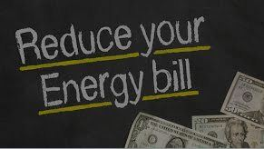
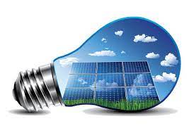
Say ‘ ’ to
Reduce Power bills
Reduce pollution
Fight Power cuts
Encourage GREEN ENERGY
Re-create & Hand over a
CLEAN & HEALTHY LIVABLE ENVIRONMENT
to your children.
.

Slide 14
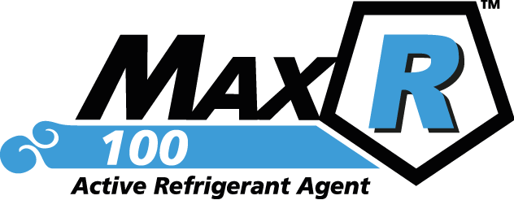

Slide 15
Final Savings of 5.5TR Ac Unit
Final Energy Savings with MAXR100™ : 6.48- 4.8 = 1.73 kWh/ Hour
Energy Savings in % : (1.73/6.47) x 100 = 26. 7 %

Slide 16
Final Savings of 8.75 TR Ac Unit:
Final Energy Savings with MAXR100™ : 8.53- 7.05 = 1.48 kWh/ Hour
Energy Savings in % : (1.48/8.53) x 100 = 17.35 %

Slide 17
OUR NEW PRODUCTS
BLDC Fans

Slide 18
Advantages of BLDC fans:
1. BLDC technology use brushless DC engines that cut power consumption by 65%.
2. BLDC motor windings utilize thick copper cables to ensure a longer lifespan and prevent overheating, minimizing winding issues.
3. BLDC fans eliminate hidden maintenance costs by not utilizing carbon brushes in their rotor and stator.
4. BLDC fans maintain high torque to secure high-quality performance.
5. BLDC fans generate minimal noise due to zero friction, unlike induction motors with carbon brushes that create noise from friction.
6. BLDC motors with electronic control systems have fewer wear-related breakdown possibilities, whereas induction motors rely on a mechanical commutation unit.

Slide 19
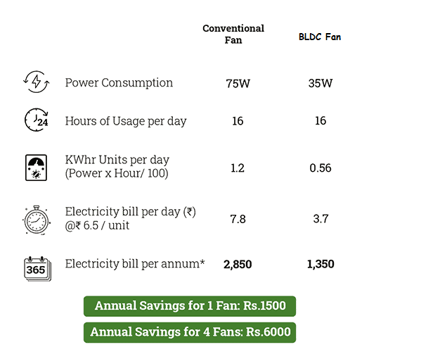

Slide 20
Our Other Products
We also deal with
Industrial Electrification & Automation
Air Conditioner Power Savers
Organic Plant Growth Promoters
XPE Insulation
Energy Audit And Energy Management Consultancy

Slide 21
Client Base
Lanco
Natsol
Devi Fisheries
Vizag Steel Roofings
SOS Children Villages (Bheemili)
Habitat for Humanity ( Araku)
Hindustan Shipyard Ltd.(HSL)
BDL(VZG)
Naval Dockyard (VZG)
INS-EKSILA & VISHWAKARMA
VIGNAN ENGG. COLLEGE(Barampuram)
IND POWER
INDO ENGLISH SCHOOL (Eluru)
Mylan Labs. Ltd.
SMS Pharmaceuticals
HBL Power Systems
Goa Glass Fibre(Binani Group)
I T C (Anaparthi & Chirala)
Net matrix
Lotus Wireless
Laurus Labs
SamKRG
Synergies Castings
Pearl Beverages(PEPSI)

Slide 22
Solar Panels Need For
Residential Homes
Commercial and Industrial Buildings
Agricultural Operations
Government and Public Facilities
Off-Grid Applications
Utilities and Grid Support
Emergency and Disaster Relief
Electric Vehicles (EVs)
Water Pumping
Space Exploration
Environmental Conservation

Slide 23
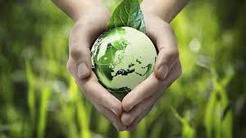
Save Energy –SAVE WATER Save OUR Mother Earth
Thank You
Any questions?
Thank You Ulti-mates!!!!
Questions Please!!!!
YES ENERGY SOLUTIONS
Mobile: 8297559060, 70
Mail: yesenergy.in@gmail.com
Web: www.yesenergyindia.com
YES Energy Solutions T: 01422 880100 W: www.yesenergysolutions.co.uk

